Slide 1
Chương 1
Giới thiệu
ĐHBK Tp HCM - Khoa Đ-ĐT
BMĐT
Môn học: Xử lý tín hiệu số với FPGA
GVPT: Nguyễn Lý Thiên Trường
Email: truongnguyen@hcmut.edu.vn
203-B3

Slide 2
Sequential circuit blocks

Slide 3
Outline
Edge-sensitive always block
Verilog for latch
Verilog for flip-flops
Blocking and Nonblocking assignments
Verilog for asyn and syn reset
Verilog for registers
Shift register
Counter
Finite State Machines (FSM)

Slide 4
always block (overview)
Level-sensitive always block
  always @ (signal1 or signal2)
  Used for combinational circuits and Latches
Edge-sensitive always block
  always @ (posedge clk)
    Response to positive edge of clk signal
  always @ (negedge clk)
    Response to negative edge of clk signal
  Used for sequential circuits and flip-flops

Slide 5
Verilog for Latch
module D_latch (D, Clk, Q);
input D, Clk;
output Q;
reg Q;
always @(D or Clk)
if (Clk)
Q = D;
endmodule
Clk
D
(
)
Q
t
+
1
(
)
0
x
Q
t
1
0
0
1
1
1
D
Q
Clk
Q
No else clause
Sensitivity list should include D and Clk

Slide 6
Verilog for D flip-flop
module flipflop (D, Clock, Q);
input D, Clock;
output Q;
reg Q;
always @(posedge Clock)
Q = D;
endmodule
D
Q
Clock
Q
Sensitivity list contains only Clock

Slide 7
Assignments (overview)
Continuous assignments – fixed connection
  assign f1 = a && b;
  assign f2 = ~ f1;
Blocking assignments – evaluate in order
  = in always block
    begin
      Q1 = D; // new Q1 will be used in evaluating all subsequent statements in this block
    Q2 = Q1; // new Q1 goes to Q2, so Q2 is equal to D.
    end
Nonblocking assignments – evaluate in parallel
  <= in always block
    begin
      Q1<= D;
    Q2<= Q1; // old Q1 goes to Q2
    end
  The order of statements doesn’t matter

Slide 8
Blocking vs. Nonblocking assignments
Initially, Q1=1, Q2=0
Initially, Q1=1, Q2=0
always @ ( posedge clk)
begin
Q1 = Q2 ;
Q2 = Q1 ;
end
always @ ( posedge clk)
begin
Q1 <= Q2;
Q2 <= Q1;
end
After one clk positive edge
After one clk positive edge
What happens
if we change the
order of two statements?
Q1=0, Q2=0
Q1=0, Q2=1
?
Q1=Q2
Q1,Q2 exchange

Slide 9
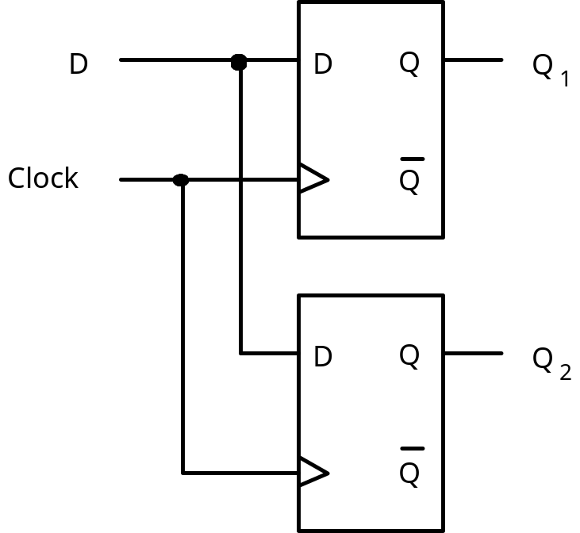
Blocking assignment
module blocking_assign (D, Clock, Q1, Q2);
input D, Clock;
output Q1, Q2;
reg Q1, Q2;
always @(posedge Clock)
begin
Q1 = D;
Q2 = Q1;
end
endmodule
Parallel Flip-Flop

Slide 10
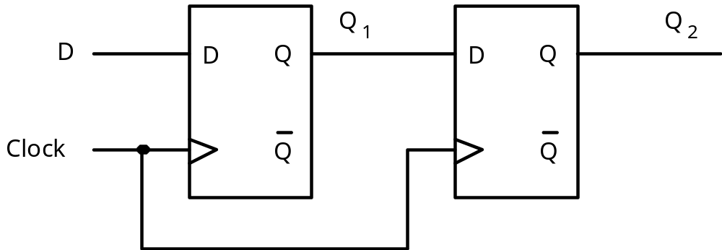
Two cascaded flip-flops
Nonblocking assignments
module nonblocking_assign (D, Clock, Q1, Q2);
input D, Clock;
output Q1, Q2;
reg Q1, Q2;
always @(posedge Clock)
begin
Q1 <= D;
Q2 <= Q1;
end
endmodule
Shift register

Slide 11
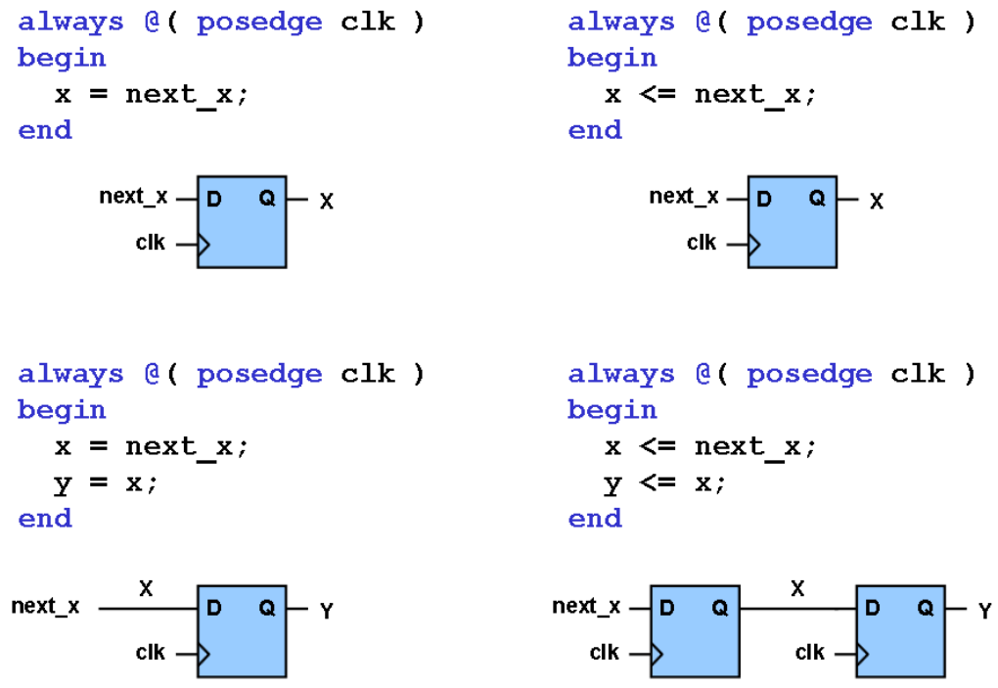
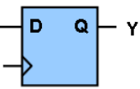
Blocking vs. Nonblocking assignment



Slide 12
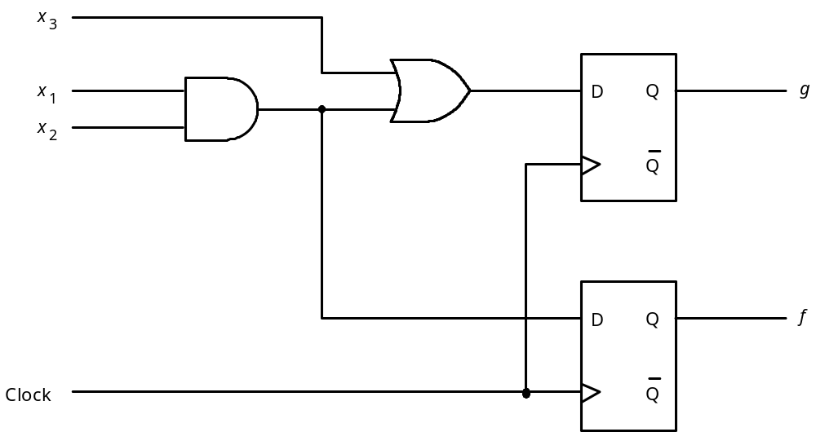
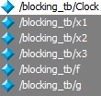
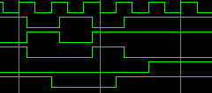
Example: Blocking assignment
module blocking_assign (x1, x2, x3, Clock, f, g);
input x1, x2, x3, Clock;
output f, g;
reg f, g;
always @(posedge Clock)
begin
f = x1 & x2;
g = f | x3;
end
endmodule
?
How about reversing the statements f and g?

Slide 13
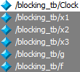
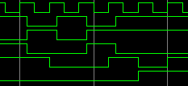
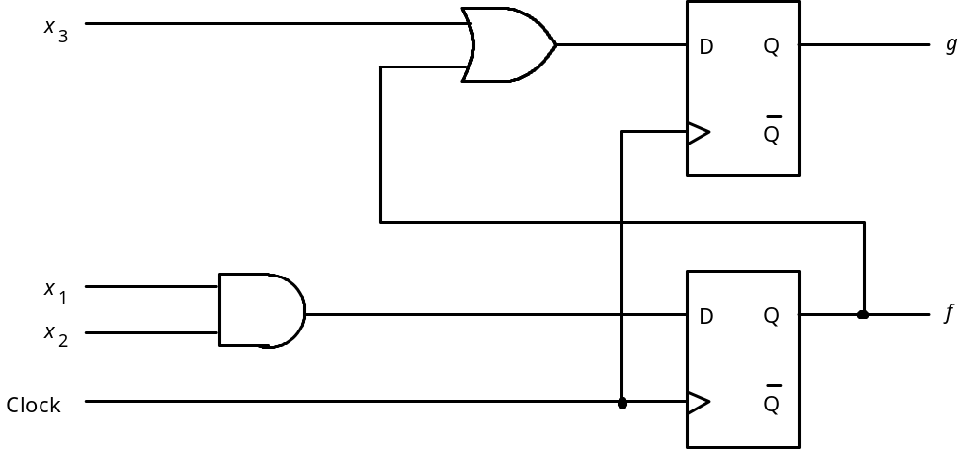
Example: Blocking assignment
module blocking_assign (x1, x2, x3, Clock, f, g);
input x1, x2, x3, Clock;
output f, g;
reg f, g;
always @(posedge Clock)
begin
g = f | x3;
f = x1 & x2;
end
endmodule

Slide 14
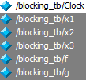
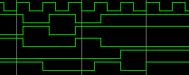
Example: Nonblocking assignment
module nonblocking_assign (x1, x2, x3, Clock, f, g);
input x1, x2, x3, Clock;
output f, g;
reg f, g;
always @(posedge Clock)
begin
f <= x1 & x2;
g <= f | x3;
end
endmodule

Slide 15
Recommendations
It is better to use blocking assignments when describing combinational circuits.
It is better to use nonblocking assignments when describing sequential circuits.

Slide 16
T flip-flop
(
)
module tff(t, clk,q);
input t, clk;
output q;
reg q;
always @ (posedge clk)
case(t)
0: q <= q;
1: q <= ~q;
endcase
endmodule
T
Q
t
+
1
0
(
)
Q
t
1
(
)
Q
t
(a) Truth table
T
Q
Q
(b) Graphical symbol

Slide 17
Flip-flop with clear capability
module flipflop (D, Clock, Resetn, Q);
input D, Clock, Resetn;
output Q;
reg Q;
always @(negedge Resetn or posedge Clock)
if (!Resetn)
Q <= 0;
else
Q <= D;
endmodule
Asynchronous reset: by using sensitivity list and if-else

Slide 18
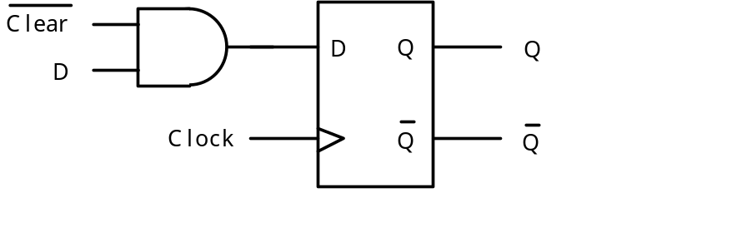
Flip-flop with clear capability
module flipflop (D, Clock, Clear, Q);
input D, Clock, Clear;
output Q;
reg Q;
always @(posedge Clock)
if (!Clear)
Q <= 0;
else
Q <= D;
endmodule
Synchronous reset: by using if-else

Slide 19
N-bit register
module regn (D, Clock, Resetn, Q);
parameter n = 16;
input [n-1:0] D;
input Clock, Resetn;
output [n-1:0] Q;
reg [n-1:0] Q;
always @(negedge Resetn or posedge Clock)
if (!Resetn)
Q <= 0;
else
Q <= D;
endmodule
D[n-1]
Q[n-1]
D
Q
D
Q
D[0]
D
Q
Q[0]
Clock
Asynchronous reset: by using sensitivity list and if-else

Slide 20
N-bit register module
module regn (D, E, Clock, Q);
parameter n = 8;
input [n-1:0] D;
input E, Clock;
output [n-1:0] Q;
reg [n-1:0] Q;
always @(posedge Clock)
if (E)
Q <= D;
endmodule
D
regn
Q
Clock
E
Synchronous enable: by using if-else

Slide 21
4-bit shift register
module shift4 (D, E, w, Clock, Q);
input [3:0] D;
input E, w, Clock;
output [3:0] Q;
reg [3:0] Q;
always @(posedge Clock)
if (E)
Q <= D;
else
begin
Q[0] <= Q[1];
Q[1] <= Q[2];
Q[2] <= Q[3];
Q[3] <= w;
end
endmodule
4
D
Q[3]
w
Clock
Q[0]
E
Comments:
This is a behavioral description
Only Clock is included in always list
Control signal E is used in if statement

Slide 22
N-bit shift register
module shift4 (D, E, w, Clock, Q);
input [3:0] D;
input E, w, Clock;
output [3:0] Q;
reg [3:0] Q;
always @(posedge Clock)
if (E)
Q <= D;
else
begin
Q[0] <= Q[1];
Q[1] <= Q[2];
Q[2] <= Q[3];
Q[3] <= w;
end
endmodule
module shiftn (D, E, w, Clock, Q);
parameter n = 16;
input [n-1:0] D;
input E, w, Clock;
output [n-1:0] Q;
reg [n-1:0] Q;
integer k;
always @(posedge Clock)
if (E)
Q <= D;
else
begin
for (k = 0; k < n-1; k = k+1)
Q[k] <= Q[k+1];
Q[n-1] <= w;
end
endmodule

Slide 23
Up-counter
module upcount (Resetn, Clock, E, Q);
input Resetn, Clock, E;
output [3:0] Q;
reg [3:0] Q;
always @(negedge Resetn or posedge Clock)
if (!Resetn)
Q <= 0;
else if (E)
Q <= Q + 1;
endmodule
Comments: asynchronous reset; counting if enable (E) is high.

Slide 24
Up-counter with parallel load
module upcount (R, Resetn, Clock, E, L, Q);
input [3:0] R;
input Resetn, Clock, E, L;
output [3:0] Q;
reg [3:0] Q;
always @(negedge Resetn or posedge Clock)
if (!Resetn)
Q <= 0;
else if (L)
Q <= R;
else if (E)
Q <= Q + 1;
endmodule

Slide 25
Sequential circuits
Finite State Machines

Slide 26
Outline
General diagram of FSMs
Two types of FSMs: Moore and Mealy
Comparison between Moore and Mealy
Introduction to Verilog for FSMs

Slide 27
Two types of FSMs
Moore-type
Combinational
Z
Combinational
Q
Flip-flops
circuit
circuit
W
Clock
Mealy-type
Combinational
Z
Combinational
Q
Flip-flops
circuit
circuit
W
Clock

Slide 28
First Verilog template for Moore FSMs
module FSM_name (Clock, Resetn, input_signal, output_signal);
input Clock, Resetn, input_signal;
output output_signal;
reg [n:1] state_present, STATE_NEXT;
parameter [n:1] STATE1 = 2'b00, STATE2 = 2'b01…. ;
// Define the next state combinational circuit
always @(input_signal or state_present)
case (state_present)
STATE1: if (input_signal) STATE_NEXT = …;
else STATE_NEXT = …;
STATE2: if (input_signal) STATE_NEXT = …;
else STATE_NEXT = …;
……
default: STATE_NEXT = n'bxx;
endcase
// Define the sequential block
always @(negedge Resetn or posedge Clock)
if (Resetn == 0) state_present <= STATE1;
else state_present <= STATE_NEXT;
// Define output
assign output_signal = ….;
endmodule
y: present state
Y: next state
3 parallel blocks:
always block:
combinational circuit for
next state
always block:
update states
assign:
combinational circuit for
output
Next state
circuit
Y
Flip-flops
y
Output
circuit
z
w
clock
Resetn

Slide 29
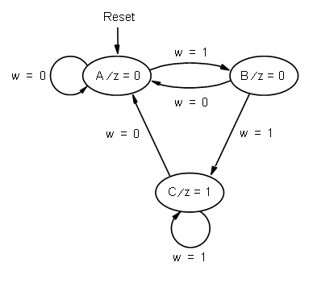
Example: Moore FSM
module simple (Clock, Resetn, w, z);
input Clock, Resetn, w;
output z;
reg [2:1] y, Y;
parameter [2:1] A = 2'b00, B = 2'b01, C = 2'b10;
// Define the next state combinational circuit
always @(w or y)
case (y)
A: if (w) Y = B;
else Y = A;
B: if (w) Y = C;
else Y = A;
C: if (w) Y = C;
else Y = A;
default: Y = 2'bxx;
endcase
// Define the sequential block
always @(negedge Resetn or posedge Clock)
if (Resetn == 0) y <= A;
else y <= Y;
// Define output
assign z = (y == C);
endmodule
y: present state
Y: next state
State assignment
Present state
input
output
Moore-type
Next state
circuit
Y
Flip-flops
y
Output
circuit
z
w
clock
Resetn

Slide 30
Second Verilog template
module FSM_name (Clock, Resetn, input_signal, output_signal);
input Clock, Resetn, input_signal;
output output_signal;
reg [n:1] state_present, STATE_NEXT;
parameter [n:1] STATE1 = 2'b00, STATE2 = 2'b01…. ;
// Define the next state combinational circuit
always @(input_signal or state_present)
begin
case (state_present)
STATE1: if (input_signal) STATE_NEXT = …;
else STATE_NEXT = …;
STATE2: if (input_signal) STATE_NEXT = …;
else STATE_NEXT = …;
……
default: STATE_NEXT = n'bxx;
endcase
// Define output
output_signal =….;
end
// Define the sequential block
always @(negedge Resetn or posedge Clock)
if (Resetn == 0) y <= STATE1;
else y <= Y;
endmodule
y: present state
Y: next state
2 parallel blocks:
always block:
combinational circuit for:
a. next state
b. output
always block:
update states
merge
Next state
circuit
Y
Flip-flops
y
Output
circuit
z
w
clock
Resetn

Slide 31
Example: Moore FSM
module simple (Clock, Resetn, w, z);
input Clock, Resetn, w;
output z;
reg z;
reg [2:1] y, Y;
parameter [2:1] A = 2'b00, B = 2'b01, C = 2'b10;
// Define the next state combinational circuit
always @(w or y)
begin
case (y)
A: if (w) Y = B;
else Y = A;
B: if (w) Y = C;
else Y = A;
C: if (w) Y = C;
else Y = A;
default: Y = 2'bxx;
endcase
// Define output
z = (y == C);
end
// Define the sequential block
always @(negedge Resetn or posedge Clock)
if (Resetn == 0) y <= A;
else y <= Y;
endmodule
y: present state
Y: next state
State assignment
Moore-type
Next state
circuit
Y
Flip-flops
y
Output
circuit
z
w
clock
Resetn

Slide 32
Third Verilog template
module FSM_name (Clock, Resetn, input_signal, output_signal);
input Clock, Resetn, input_signal;
output output_signal;
reg [n:1] state; // don’t need state_present, STATE_NEXT;
parameter [n:1] STATE1 = 2'b00, STATE2 = 2'b01…. ;
// Define the sequential block
always @(negedge Resetn or posedge Clock)
if (Resetn == 0) state <= STATE1;
else
case (state)
STATE1: if (input_signal) state <= …;
else state <= …;
STATE2: if (input_signal) state <= …;
else state <= …;
……
default: state <= n'bxx;
endcase
// Define output
assign output_signal=….;
endmodule
y: present state
Y: next state
2 parallel blocks:
always block:
sequential circuit for:
next state
and update
assign block:
for output
merge
Next state
circuit
Y
Flip-flops
y
Output
circuit
z
w
/*assign cannot be put inside
the always block*/
clock
Resetn

Slide 33
Example: Moore FSM
module simple (Clock, Resetn, w, z);
input Clock, Resetn, w;
output z;
reg [2:1] y;
parameter [2:1] A = 2'b00, B = 2'b01, C = 2'b10;
// Define the sequential block
always @(negedge Resetn or posedge Clock)
if (Resetn == 0) y <= A;
else
case (y)
A: if (w) y <= B;
else y <= A;
B: if (w) y <= C;
else y <= A;
C: if (w) y <= C;
else y <= A;
default: y <= 2'bxx;
endcase
// Define output
assign z = (y == C);
endmodule
Moore-type
/*assign cannot be put inside
the always block*/

Slide 34
Summary of Verilog for FSMs
No standard way for writing code that represents an FSM.
However, there are 3 templates we can use to code, based on state diagram.
The 3 templates provide identical functionality, but may produce different circuits.
The first two templates are recommended.
Similar templates exist for Mealy FSMs

Slide 35
Verilog for Mealy FSMs
Similar to Moore FSMs
The main difference between Mealy and Moore:
  For Moore, the output is defined independent of inputs, so the code for output is separated from the code for state transitions, e.g. case
  For Mealy, the code for output is written within the case statement that also defines the state transitions.
Two parallel blocks:
  always @ (inputs or current_states) defines the next state and output.
  alwasy @ (negedge resetn or posedge clock) defines flip-flops.

Slide 36
Verilog template for Mealy FSMs
module FSM_name (Clock, Resetn, input_signal, output_signal);
input Clock, Resetn, input_signal;
output output_signal;
reg [n:1] state_present, STATE_NEXT;
parameter [n:1] STATE1 = 2'b00, STATE2 = 2'b01…. ;
// Define the next state combinational circuit and outputs
always @(input_signal or state_present)
case (state_present)
STATE1: if (input_signal) define output and next state;
else define output and next state;
STATE2: if (input_signal) define output and next state;
else define output and next state;
……
default: define output and next state;
endcase
// Define the sequential block
always @(negedge Resetn or posedge Clock)
if (Resetn == 0) y <= STATE1;
else y <= Y;
endmodule
y: present state
Y: next state
2 parallel blocks:
always block:
combinational circuit for
next state and output
always block:
update states
Next state
circuit
Y
Flip-flops
y
Output
circuit
z
w
clock
Resetn

Slide 37
Example: Verilog for Mealy
module mealy (Clock, Resetn, w, z);
input Clock, Resetn, w;
output z;
reg y, Y, z;
parameter A = 0, B = 1;
// Define the next state and output
//combinational circuits
always @(w or y)
case (y)
A: if (w)
begin
z = 0; Y = B;
end
else // w = 0
begin
z = 0; Y = A;
end
B: if (w)
begin
z = 1; Y = B;
end
else
begin
z = 0; Y = A;
end
endcase
2 parallel blocks:
always block:
combinational circuit for next state and output
always block:
update states
// Define the sequential block
always @(negedge Resetn or posedge Clock)
if (Resetn == 0) y <= A;
else y <= Y;
endmodule
Reset
state
w
=
1
⁄
z
=
0
A
B
w
=
0
⁄
z
=
0
w
=
1
⁄
z
=
1
w
=
0
⁄
z
=
0
input
output
Mealy-type

